Slide 1

10 way How to improve your health

Slide 2


1.Eat slowly
According to research, faster eaters are
More likely than slow eaters to be overweight.

Slide 3


2.Drink more water
Drink at least 8 glasses of water a day.

Slide 4

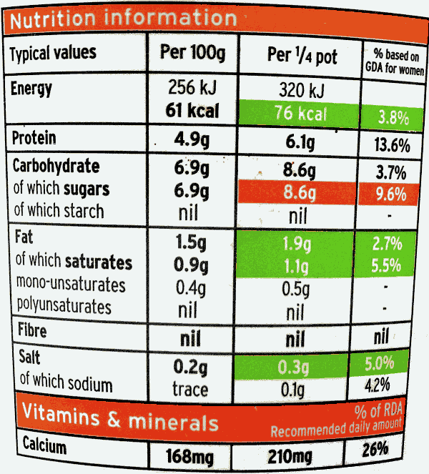
3. Read numtrition labels
Avoid only reading maketing labels like
“low fat” or “zero sugar”, as these labels
May be misleading.

Slide 5



4. Eat more fruits and vegetables
A diet rich in fruit and vegetables can help protect you abainst cancer ,diabetes and heart disease.

Slide 6

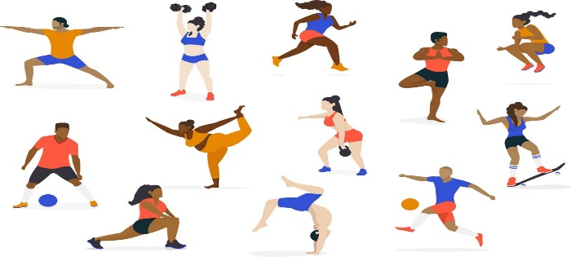



5. Work out (at least) 3 times a week
You can try to:
Start your day with a stretch
Do more of an activity you’re already doing
Start doing an activity you think you’ll enjoy doing

Slide 7
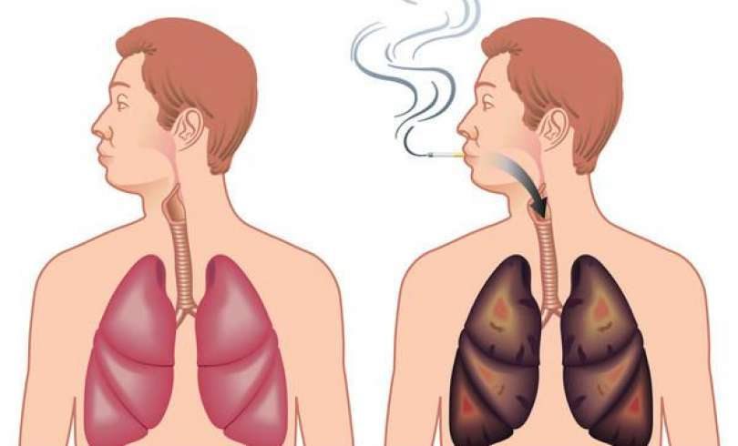

6. Quit smoking
About 6 Singaporeans die prematurely
From smoking-related diseases every day
Source from HealthHub Smoking Statistcs in Singapore

Slide 8



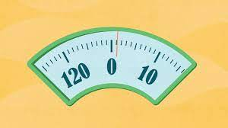
7. Get a fitness tracker (and use it)
A fitness tracker can track your:
Heart rate
Distance of your run
Number of your calories you burn during workouts

Slide 9

8. Sleep for 6 – 8 hours daily
According to research, people who get less than 7 hours of sleep a night are 12% more likely to die prematurely

Slide 10

9. Smile and laugh more
Laughing allows you to breathe deeper and take in more air, which stimulates your heart, lubhs and muscles.

Slide 11

10. Keep a jounal of daily wins
Keeping a daily diary of progress helps us to reflect on our days and record all the small achievenments that would otherwise go unnoticed

Slide 12
THANK YOU!

